Slide 1
Career Skills Assessment 1
Romeo Alvarenga, Evan Hardy, Yann Mbianga, Ojie Okodogbe, Devon Wilkes

Slide 2

Agenda
Client Background
Introduction
Approach
Findings and Outcomes
Impact
Reflection and Next Steps
1
2
3
4
5
6

Slide 3
Client Background
Client: iConsultancy
Founded: 2019 | Based in College Park, MD
Affiliation: UMD College of Information Studies
Mission: Enable students to gain real world experience while helping organizations solve information challenges
Programs Managed: Over 150 projects annually | ~700 students
Growth Goals: Double project volume within 12–18 months
Client Contact: TJ Rainsford | tjrains@umd.edu

Slide 4

Introduction
Why This Matters:
Supports UMD’s mission of workforce development
Helps iSchool students explore untapped job opportunities
Assists Maryland employers in recognizing student capabilities
Key Challenges:
Aligning academic learning outcomes with real world job roles
Identifying emerging career paths in a changing job market
Our Team’s Role:
Act as research analysts and design strategists
Link programs to career paths
Create clear and helpful visuals for stakeholders

Slide 5
Approach
Client Research and Consultation
Project Plan and Deliverables
Workforce Needs For State Of Maryland (labor.maryland.gov)
Long Term and Short Term Occupational Projections
In-Demand Job Industries
Alignment to INFO College Majors
Career Skill Matrix
Visualizations and Deliverables
Infographics, Report, Catalog, Career Skill Matrix
White Paper (In Collaboration with Career Skills Assessment 2)

Slide 6
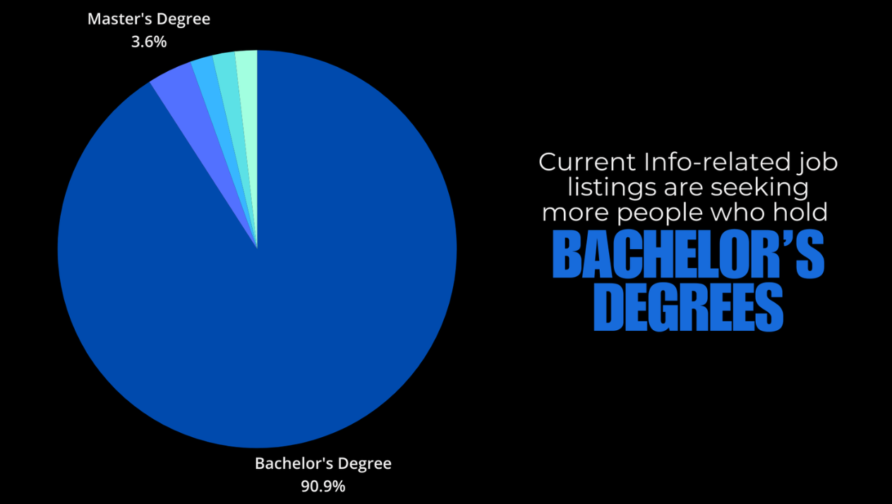
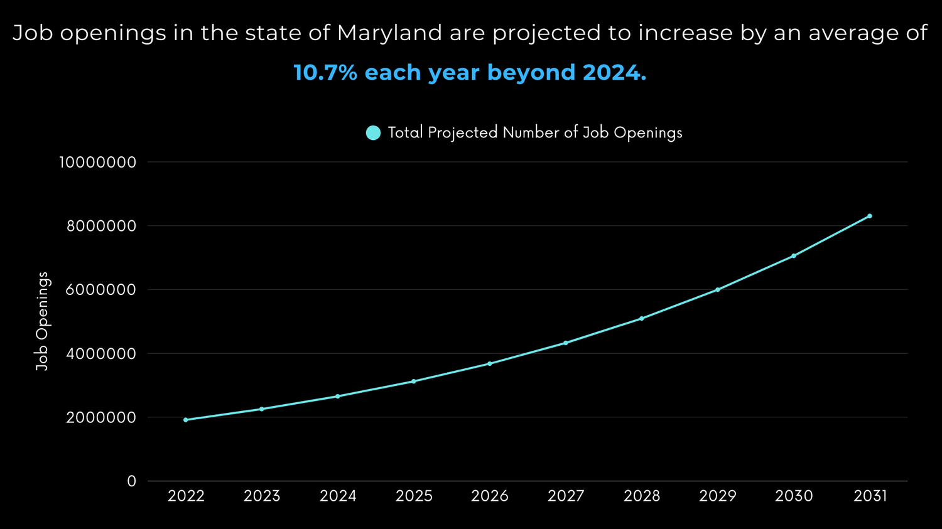
Findings
IT related jobs have some of the most growth amongst all industries.
Growth averaged 10.77%
The top 10 IT roles were the most in line with ISchool skills.
Over 90% of jobs require only a Bachelor's degree.
IT median wage is more than double the median for all occupations.

Slide 7
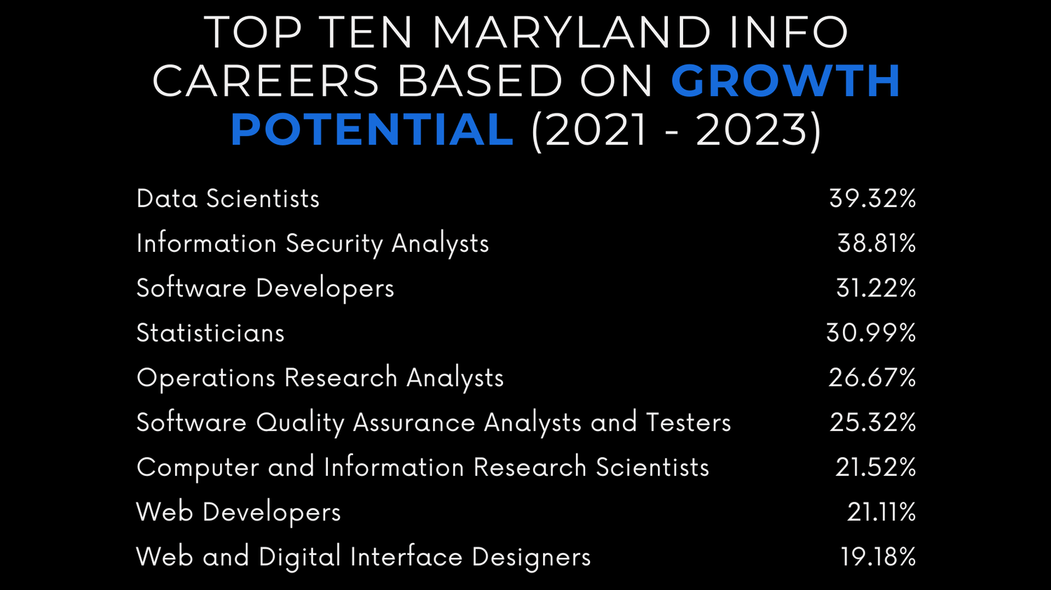
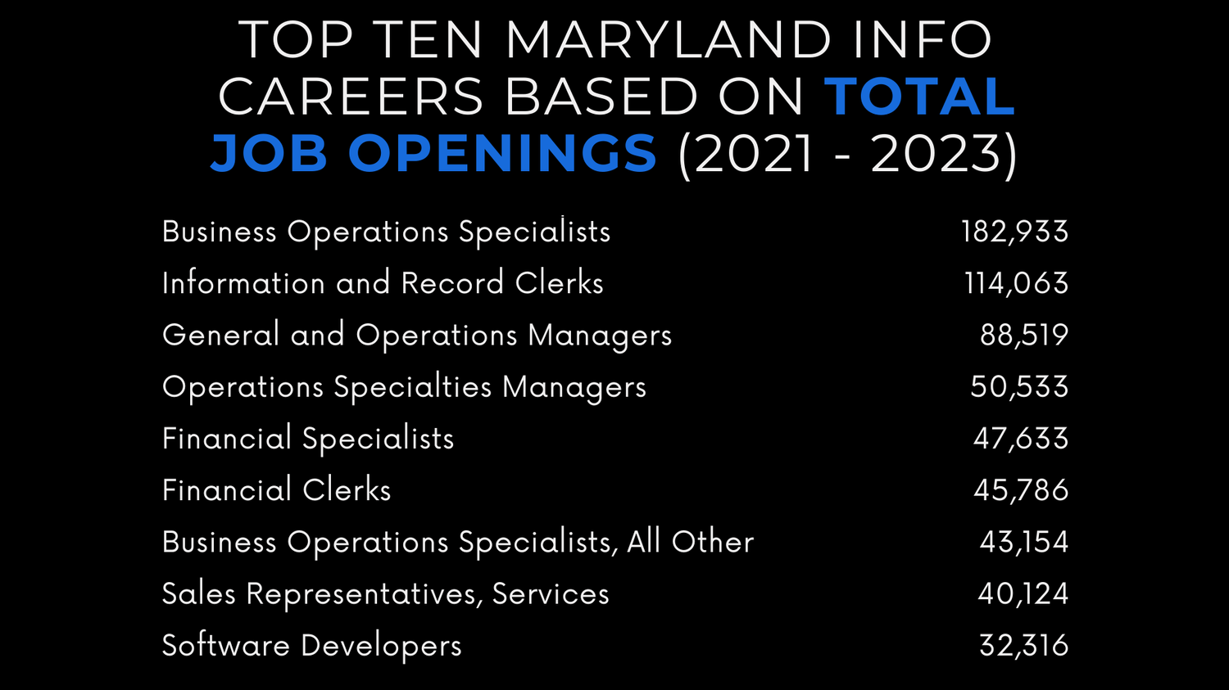
Outcomes
Students NEED to be more aware of these facts.
iSchool students can apply to far more than just ‘Data Analyst’ positions.
There is not only a high demand for IT jobs, but that demand is growing at one of the highest rates for any industry.

Slide 8
Catalog
https://docs.google.com/presentation/d/1LAQMmUHxmPTDl86FD08IB5hpkdegJN7xY_1US1KHYLU/edit#slide=id.g34ff4a51914_1_0

Slide 9
Impact
Bridges the skills-to-market gap.
Expands career visibility for students.
Strengthens employer engagement.
Empowers iConsultancy's mission.

Slide 10
Reflection & Next Steps
Deliverables
A detailed skills matrix across the three primary INFO college major programs.
A skills catalog designed to educate students and engage recruiters about job market trends and needs.
A white paper report that connects the skills acquired in College of Information programs with the evolving demands of the Maryland job market. (In Collaboration with Career Skills Assessment 2)

Slide 11
Reflection & Next Steps
Recommendations
To ensure continued impact beyond this project, we recommend the iConsultancy to take the following steps:
Promote Materials Digitally: Publish materials on INFO college website, areas viewed by prospective employers and students.
Leverage Career Services: Integrate materials into workshops, career fairs, and advising sessions.
Educate Students: Short seminars or info sessions highlighting paths beyond traditional roles, using the materials as tools.

Slide 12

Thank You!

